Slide 1
Computer aided software engineering
Software maintenance
Software reuse

Slide 2
Introduction
Software maintenance:
  any modifications to a software product after it has been delivered to the customer.
Software maintenance is an important activity for many organizations.

Slide 3
Introduction
Maintenance is inevitable for almost any kind of product.
Most products need maintenance:
  due to wear and tear caused by use.
Software products do not need maintenance on this count.

Slide 4
Introduction
Many people think
  only bad software products need maintenance.
The opposite is true:
  bad products are thrown away,
  good products are maintained and used for a long time.

Slide 5
Introduction
Software products need maintenance for three reasons:
  corrective
  adaptive
  perfective

Slide 6
Corrective
Corrective maintenance of a software product:
  to correct bugs observed while the system is in use.
  to enhance performance of the product.

Slide 7
Adaptive
A software product needs maintenance (porting) when customers:
  need the product to run on new platforms,
    or, on new operating systems,
  need the product to interface with new hardware or software.

Slide 8
Perfective
Perfective maintenance:
  to support new features required by users.
  to change some functionality
  of the system due to customer demands.

Slide 9
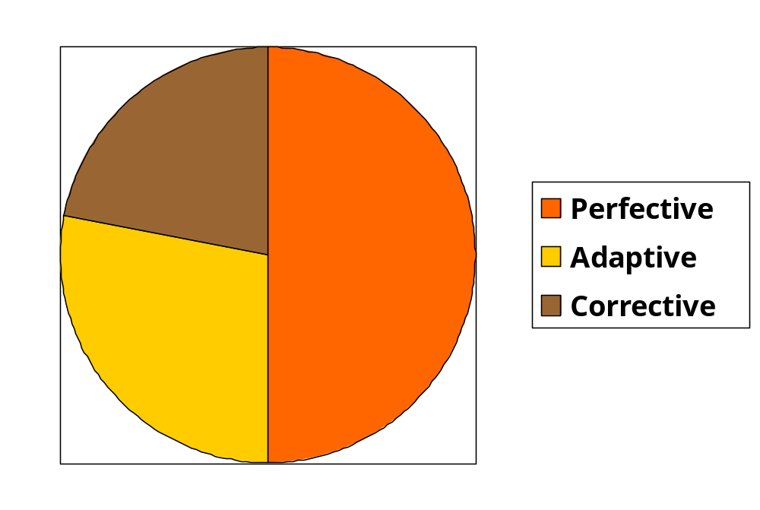
Maintenance Effort Distribution

Slide 10
Causes for maintenance
Users want existing software to run on new platforms:
  to run in new environments,
  and/or with enhanced features.

Slide 11
Causes for maintenance
Whenever other software it works with change:
  maintenance is needed to cope up with the newer interface.
  For instance, a software product may need maintenance when the operating system changes.

Slide 12

Laws of Maintenance
There will always be a lot
of old software needing
maintenance.
Good products are
maintained, bad products
are thrown away.

Slide 13
Laws of Maintenance
Lehman’s first Law:
“Software products must change continuously, or become progressively less useful.”

Slide 14
Laws of Maintenance
Lehman’s Second Law
“When software is maintained, its structure degrades,
  unless active efforts are made to avoid this phenomenon.”

Slide 15
Laws of Maintenance
Lehman’s Third Law:
“Over a program’s life time,
  its rate of development is approximately constant.”

Slide 16
Legacy code--- Major maintenance problems
Unstructured code (bad programs)
Maintenance programmers have:
  insufficient knowledge of the system or the application domain.
  Software maintenance has a bad image.
Documentation absent, out of date, or insufficient.

Slide 17
Insufficient knowledge
Maintenance team is usually different from development team.
  even after reading all documents
    it is very difficult to understand why a thing was done in a certain way.
  Also there is a limit to the rate at which a person can study documents
    and extract relevant information

Slide 18
Bad image of maintenance?
Maintainers are skilled not only in writing code:
  proficient in understanding others’ code
  detecting problems, modifying the design, code, and documentation
  working with end-users

Slide 19
Maintenance Nightmares
Use of gotos
Lengthy procedures
Poor and inconsistent naming
Poor module structure
Weak cohesion and high coupling
Deeply nested conditional statements
Functions having side effects

Slide 20
Question
Which of the following phase of SDLC takes maximum efforts?
Design
Coding
Testing
Maintenance

Slide 21
Question
Which of the following statement is correct for lehman’s first law of maintenance?
Software products must change continuously, or become progressively less useful
When software is maintained, its structure degrades
Over a program’s life time, its rate of development is approximately constant
None of the above

Slide 22
How to do better maintenance?
Program understanding
Reverse engineering
Design recovery
Reengineering
Maintenance process models

Slide 23
Maintenance activities
Two types of activities:
  Productive activities:
    modification of analysis, design, coding, etc.
  Non-productive activities:
    understanding system design, code, etc.

Slide 24
Question
In which of the following maintenance activity modification is done?
Productive activities
Non-productive activity
Recovery activity
None of the above

Slide 25
Software reengineering
Forward engineering is carried out to produce the new code.
During design, module specification, and coding:
  substantial reuse is made from the reverse engineered products.

Slide 26
Process model for Software reengineering
Change Requirements
Requirements Specification
New Requirements Specification
Design
Design
Code
Code

Slide 27
Software reengineering
Advantages of reengineering:
  produces better design than the original product,
  produces required documents,
  often results in higher efficiency.

Slide 28
Software reengineering
Reengineering is preferable when:
  amount of rework is high,
  product exhibits high failure rate.
  product difficult to understand.

Slide 29
Software Reverse Engineering
It means backward, software is developed but we want to analyse how it has been developed.
Process to move backward from the phase of development/deployment to design/coding/requirement phase.
By analyzing a program code, recover from it:
  the design and the requirements specification.

Slide 30
Real life examples
Suppose, Maruti has launched new design car. Its competitors like Tata, Hyundai etc analyse new techniques, tools, design that Maruti has used in its new model.
They will check mileage, seating capacity, ground clearance, design cost, profit to name but a few.
Point is : Output has come but analysis is still going on in order to see how it has been implemented.
On that basis, competitors will introduce/launch new model.

Slide 31
2. Suppose you want to make shopping website then you will refer flip cart, amazon, ebay etc to analyze tools, techniques and design successful companies are using.
On that basis, decisions will be taken.
Reverse Engineering is important when ideas are less.
To ensure that produced product will be up-to-date.

Slide 32
Software Reverse Engineering
In order to extract the design:
  fully understand the code.
Automatic tools can be used to help derive:
  data flow and control flow diagrams from the code.
Extract requirements specification:
  after thoroughly understanding the code

Slide 33
Cosmetic changes
Reformat Program
Assign Meaningful
Names
Simplify Conditions
Simplify Processing
Replace GOTOs

Slide 34
Cosmetic Changes
Cosmetic testing deals with: More excellent looks of the buttons and texts.
Reformat the program:
  layout the program neatly.
Give more meaningful names to:
  Variables, data structures, and functions.

Slide 35
Cosmetic Changes
Replace complex and nested conditional expressions:
  simpler conditional statements
  whenever appropriate use case statements.

Slide 36
Forward Engineering
Forward Engineering is a method of creating or making an application with the help of the given requirements.
Forward engineering is also known as Renovation and Reclamation.
Forward engineering is required high proficiency skill. It takes more time to construct or develop an application.

Slide 37
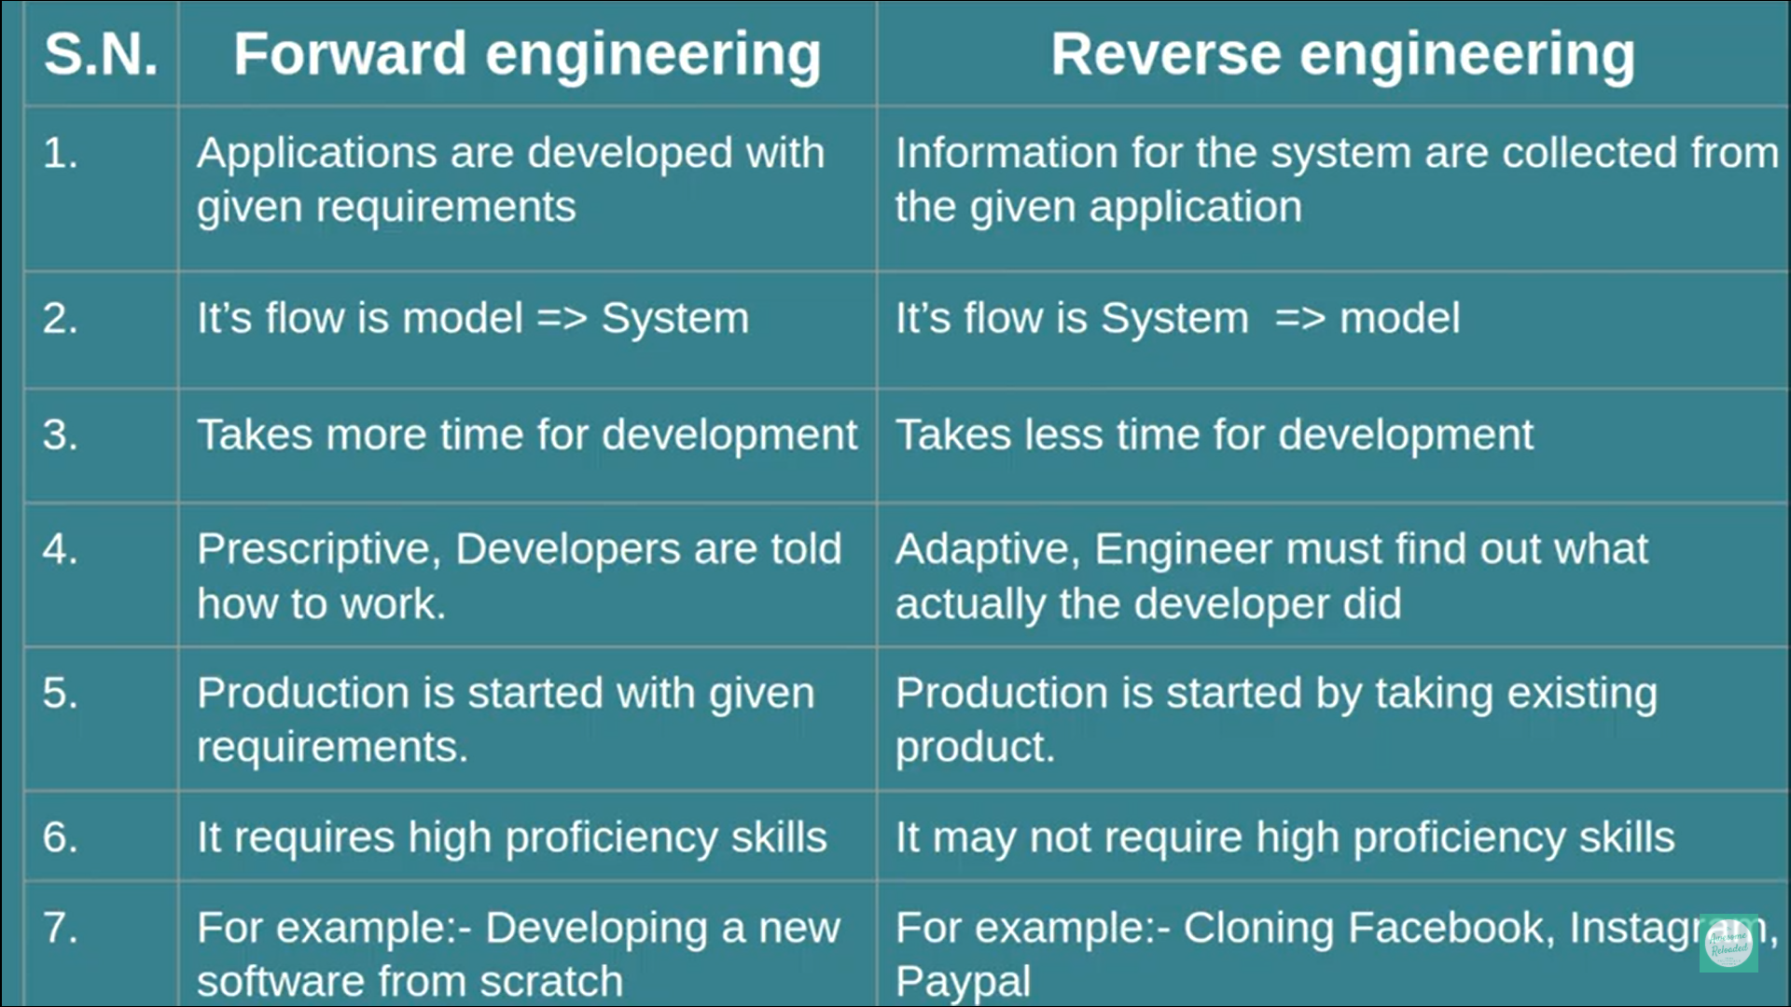

Slide 38
Facebook cloning is a scam in which the attacker copies the profile picture of an authorized user, creates a new account using that person’s name and sends friend requests to people on the user’s list.
The exploit is often successful because many unsuspecting friends just accept the scammer’s requests, assuming that the actual user has created a new account for some reason or forgetting that they are already friends with that person.

Slide 39
Reengineering
Many aging software products belong to this category.
Reengineering means Engineering has been done, we want to do it again.
It doesn’t mean that all phases/processes has to be processed again.
It means software has been developed but some modifications are required so that it will work in a better way.

Slide 40
Real life examples
Decades ago, Mobile was already developed. The basic purpose was to make a call only. It was done.
But why companies reengineer it again and again?? In order to provide more efficient and fruitful product.
Start with adding feature of
SMS’s
FM radio
saved upto 300 contact numbers
Bluetooth
Dual sim
Memory card
We are on the way of improving it by reengineering.

Slide 41
Camera in mobiles is not an exception.
Dual camera
Selfie camera
Triple camera
Camera with AI
Camera with flash
Camera with auto flash and so on..
Camera in mobiles has also gone through this process of reengineering in order to make it more user friendly and useful product.

Slide 42
Any example of Reengineering in terms of software???
1. Windows!!
Suppose booting time for windows developed is 2 minutes.
Company wishes to reduce it to 1 min 45 sec or less.
If a company could save even a single second of customer then it will be beneficial too.
2. XYZ software is working properly in all aspects and its storage capacity is 35 MB. Suppose Company wishes to introduce a next version with less storage. Reengineering is the key.

Slide 43
3. Updates received on facebook, whatsapp are the results of company reengineering processes that are going on at backend.

Slide 44
Process model for Software reengineering
Change Requirements
Requirements Specification
New Requirements Specification
Design
Design
Code
Code

Slide 45
Software reengineering
Advantages of reengineering:
  produces better design than the original product,
  produces required documents,
  often results in higher efficiency.

Slide 46
Software reengineering
Reengineering is preferable when:
  amount of rework is high,
  product exhibits high failure rate.
  product difficult to understand.

Slide 47
Computer Aided Software Engineering (CASE)
Computer aided + software Engineering
Computer helps SE.
In SE: SDLC model, waterfall model, spiral model etc.. are there. How case tools helps?
What are they?

Slide 48
In simple words, whatever task you are doing in SE, if you have taken the help of computer then it is CASE.
Step by step explanation:
Requirement gathering phase: Online Survey, Online interviews, online questionnaire etc.
Or suppose manual survey was there and then graph is derived from it with the help of excel.

Slide 49
Design: DFDs, UML diagrams, use case diagrams, flowcharts etc.. Instead of generating them manually , some software is used: CASE TOOL
Coding: Programming languages, it is a part of computer: CASE tool

Slide 50
Testing: automated tools are used, simply upload the code and then system will tell bugs and ways to fix it. It will tell various results of unit testing, regression testing, integrated testing and so on..: CASE TOOLS.

Slide 51
Maintenance: developed system have auto repair mode.
Eg: corrupted MS word file restores itself automatically.
While using internet in google chrome, system hangs and you have to shutdown.
When you reopen it, it gives you option: “do you want to restore?”
It enables you to repair automatically. Variety of tools are there.

